Slide 1


Principles of Programming Languages
(CS F301)
Jabez Christopher
Assistant Professor
Department of CSIS

Slide 2
Formal Methods of Describing Syntax
Regular Expression
BNF
EBNF
Attribute grammar (Syntax & Semantics)

Slide 3
Regular Expressions
• The lexemes of a programming languages are described formally by the use of regular expressions, where there are 3 operations, concatentation, repetition and selection:
— alb denotes a or b.
— ab denotes a followed by b
— (ab)* denotes a followed by b zero or more times
— (alb)c denotes a or b followed by c
• There are other operators that we can add to regular expression notations that make them easier to write:
[a-z] any character from a through z
r+ one or more occurrences of r
? An optional term
. Any one character
• Examples
[0-9]+ describes an integer
[0-9]+(\. [0-9]+)? describes an unsigned real

Slide 4
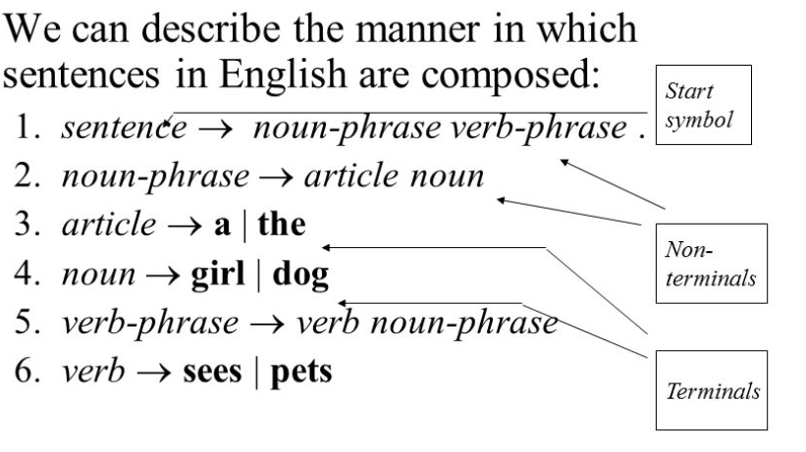
Grammar
The grammar of a language is expressed formally as
G = (T, N, S, P) where
T is a set of terminals (the basic, atomic symbols of a language).
N is a set of nonterminals (symbols which denote particular arrangements of terminals).
S is the start symbol (a special nonterminal which denotes the program as a whole).
P is the set of productions (rules showing how terminals and nonterminal can be arranged to form other nonterminals).

Slide 5
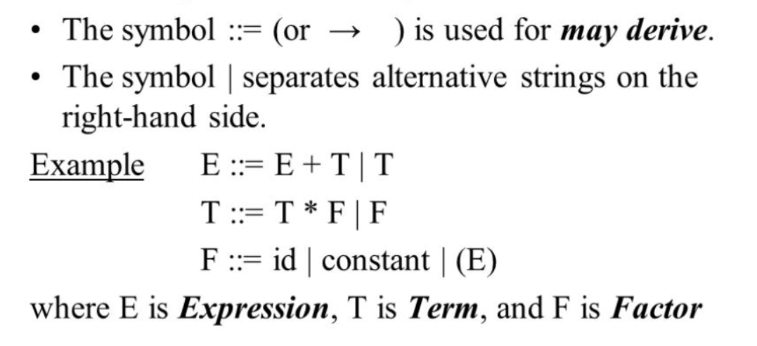
Context-Free Grammars and BNFs
• Context-Free grammars are grammars where non-terminals (collections of tokens in a language) always are deconstructed the same way, regardless of the context in which they are used.
• BNF (Backus-Naur form) is the standard notation or metalanguage used to specify the grammar of the language. It is a metalanguage for describing a context-free grammar.

Slide 6
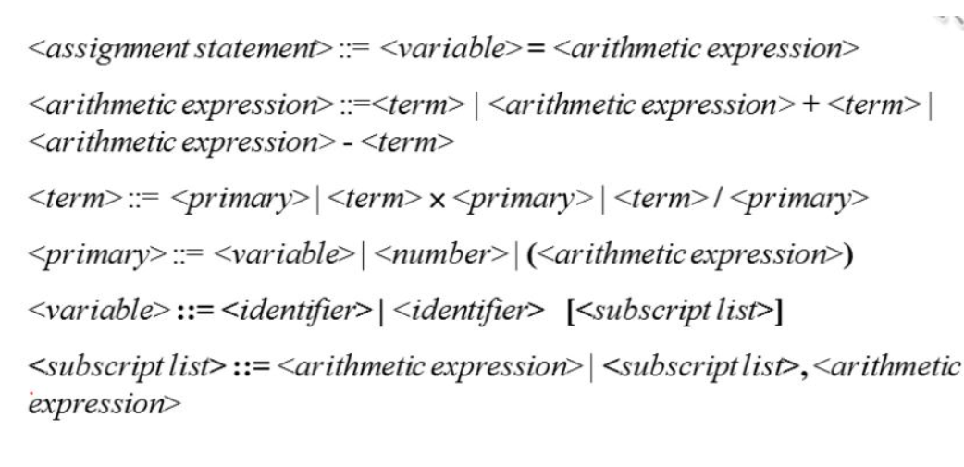
BNF: Example

Slide 7
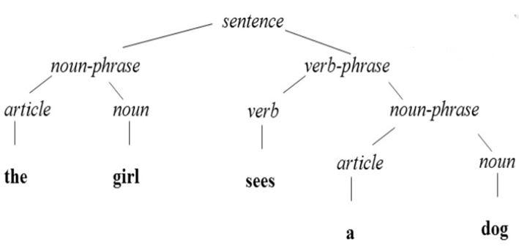
PARSE TREE
Every internal node of a parse tree is labeled with a nonterminal symbol;
Every leaf is labeled with a terminal symbol.
Every subtree of a parse tree describes one instance of an abstraction in the Grammar sentence.

Slide 8
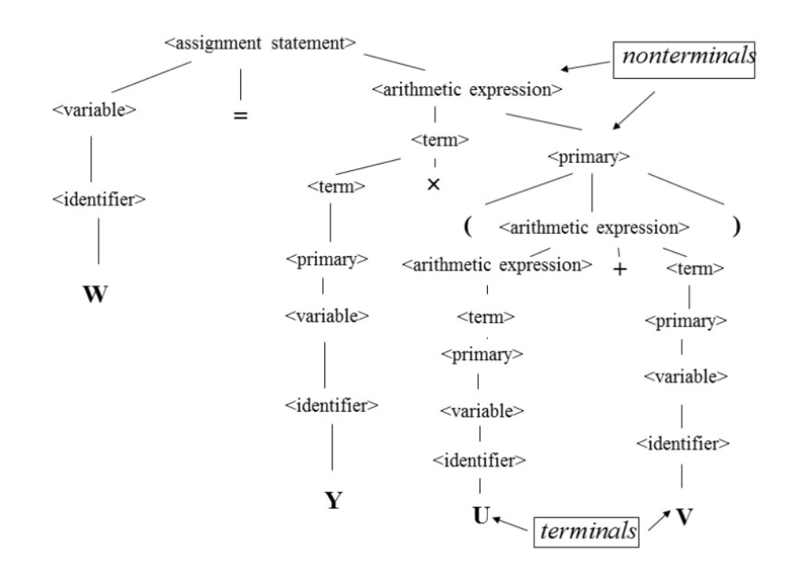
PARSE TREE: Example

Slide 9
Extended BNF
[ ] | an optional part of an RHS, which is delimited by brackets.
{ , } | use of braces in an RHS indicates that the enclosed part can be repeated indefinitely or left out altogether
( I ) | multiple-choice options: When a single element must be chosen from a group, the options are placed in parentheses and separated by the OR operator (pipe symbol)

Slide 10
EBNF compared to BNF
BNF:
expression → expression + term
| expression - term
| term
term → term * factor
| term / factor
| factor
factor → ( expression )
| id
| number
EBNF:
expression → term { (+|-) term }
term → factor { (*|/) factor }
factor → '(' expression ')’|id |number

Slide 11
Attribute grammar
A device used to describe more of the structure of a programming language than can be described with a context-free grammar
It provides a formal framework for decorating parse trees
An attribute grammar is an extension to a context-free grammar
It consists of
Attributes: associated with grammar symbols (the terminal and nonterminal symbols),
Attribute computation functions: associated with grammar rules
Predicate functions: state the static semantic rules of the language, are associated with grammar rules.

Slide 12
Attribute grammar
It allows certain language rules to be conveniently described, such as type compatibility
STATIC SEMANTICS of a language is indirectly related to the meaning of programs during execution; rather, it has to do with the legal forms of programs (syntax rather than semantics). Many static semantic rules of a language state its type constraints.
The analysis required to check these specifications can be done at compile time.
The process of evaluating attributes is called annotation, or DECORATION, of the parse tree
If all attributes are inherited, the evaluation process can be done in a top-down order
Alternatively, if all attributes are synthesized, the evaluation can proceed in a bottom-up order

Slide 13
Attributes
Associated with each grammar symbol X is a set of attributes A(X). The set A(X) consists of two disjoint sets: S(X) and I(X)
S(X): synthesized attributes, pass semantic information bottom-up in a parse tree
I(X): inherited attributes, pass semantic information down or across a tree. Similar to variables because they can also have values assigned to them
Synthesized attributes of leaf nodes whose values are determined outside the parse tree
E.g., the type of a variable can come from the symbol table
Given the intrinsic attribute values on a parse tree, the semantic functions can be used to compute the remaining attribute values

Slide 14
Semantic Functions
For a rule X₀ →X₁ …X_{n} , the synthesized attributes of X₀ are computed with semantic functions of the form S(X₀ ) = f(A(X₁), …, A(X_{n})
The value of a synthesized attribute on a parse tree node depends only on the attribute values of the children node
Inherited attributes of symbols X_{j}, 1≤j≤n, are computed with a semantic function of the form I(X_{j}) = f(A(X₀), …, A(X_{n}))
The value of an inherited attribute on a parse tree node depends on the attribute values of the node’s parent and siblings

